Slide 1
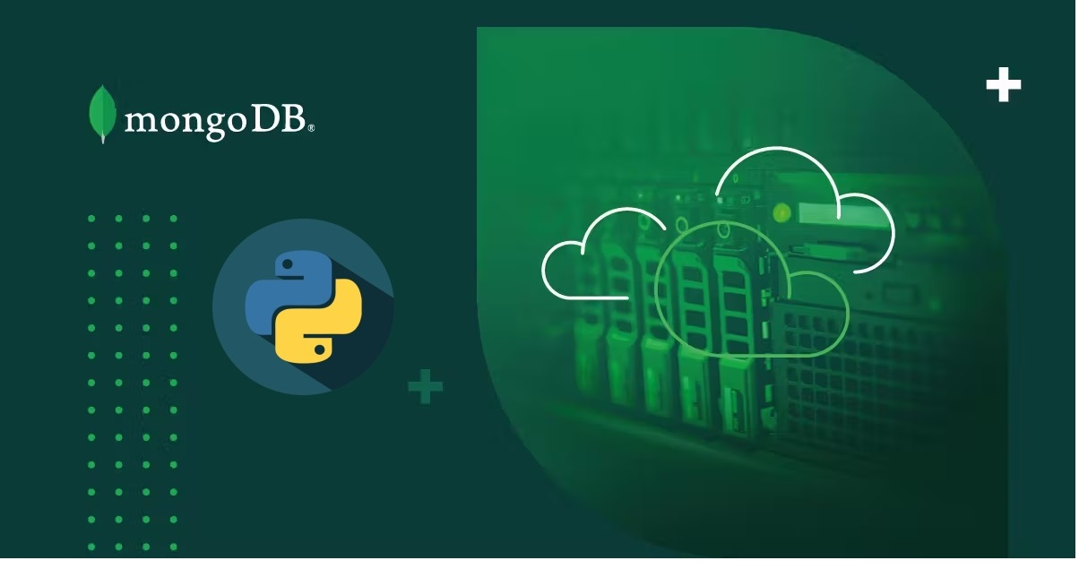
Python Mongo Connectivity

Slide 2

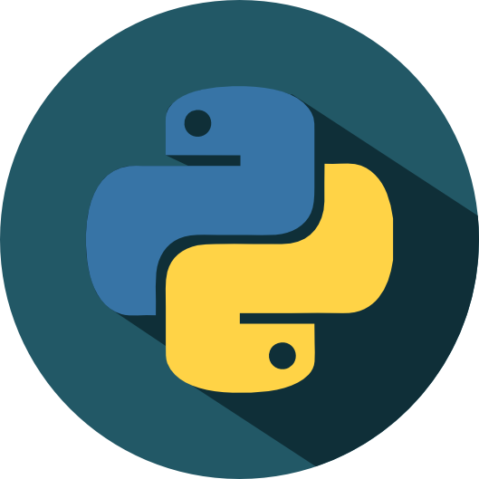
Introduction to Python
Designed by :- Guido van Rossum
Python is a high-level, general-purpose programming language.
Its design philosophy emphasizes code readability with the use of significant indentation.
It supports multiple programming paradigms, including structured (particularly procedural), object-oriented and functional programming.

Slide 3
Why python is a popular choice for Database Connectivity
Cross Platform Compatibility :
Python is a cross-platform language and this makes it a versatile choice for connecting to databases on different platforms
Great Community Support:
Python has a large and active community of developers. This community support can be of very good help when one will encounter issues
Abundance of Libraries:
Python has a rich ecosystem of libraries and frameworks that simplify database connectivity.

Slide 4
Why python is a popular choice for Database Connectivity
Scalability:
Python is suitable for both small-scale and large-scale applications
Data Analysis and Machine Learning:
Python is widely and extensively used in data analysis and machine learning

Slide 5
Introduction to Mongodb
MongoDB :
Most popular NoSQl database
Open source document oriented DB
Indexing - efficient searching
Scales horizontally using sharding.
Replication and high availability
It provides aggregation

Slide 6
Why we use Mongodb with python ??
JSON-Like Documents:
Stores data in BSON format which is similar to Python native data structures
such as dictionaries and lists
Scalability:
Can handle large datasets and high-throughput workloads.
Scales horizontally using sharding
Real-Time Data:
Ability to handle real-time data makes it a suitable choice when combined with Python.

Slide 7
Why we use Mongodb with python
Geospatial Data:
Python application involves geospatial data and location-based services
MongoDB's built-in geospatial indexing and querying capabilities are highly valuable.
Ex. Mapping
NoSQL Flexibility:
Python is a dynamically-typed language
MongoDB's schema-less design complements this flexibility.
well-suited for projects with evolving data requirements.
Easy Integration:
Provides an official Python driver called PyMongo.

Slide 8
Connecting Mongodb with python
PyMongo
Pymongo is the official Python driver for MongoDB .
To use PyMongo, you need to install it using pip (the Python package manager)
import the library into your Python script.

Slide 9
Connecting Mongodb with python
MongoClient
MongoClient is class of pymongo library
The client object created here represents your connection to the MongoDB server, and you can use it to access databases and perform various database operations.
When you create an instance of MongoClient, you provide it with the connection details, such as the server's URI or hostname, and optionally, the port number.

Slide 10
Lets move to practical part
Python Notebook
https://drive.google.com/file/d/1HaDQAkG8UEqvXzixLDh2FU1FJ4MsfLhd/view?usp=sharing

Slide 11
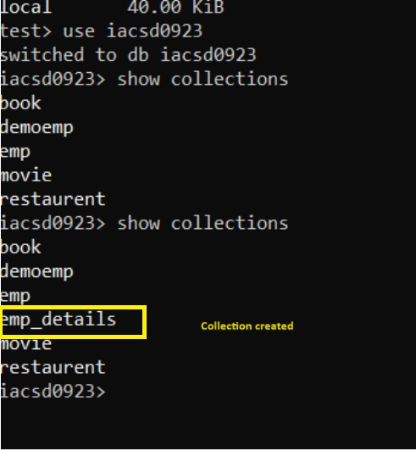
Collection created

Slide 12
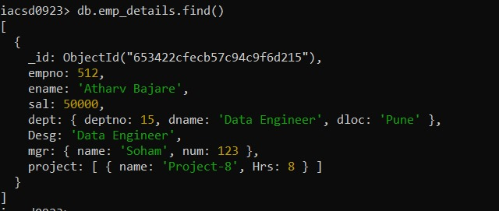
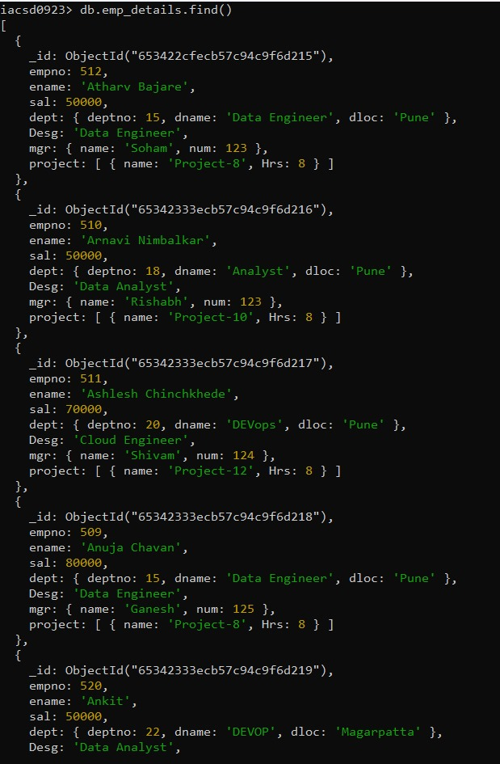
Insert Operation
insert_one(data)
insert_many([data1,data2,...])

Slide 13
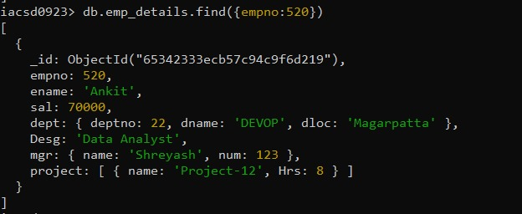
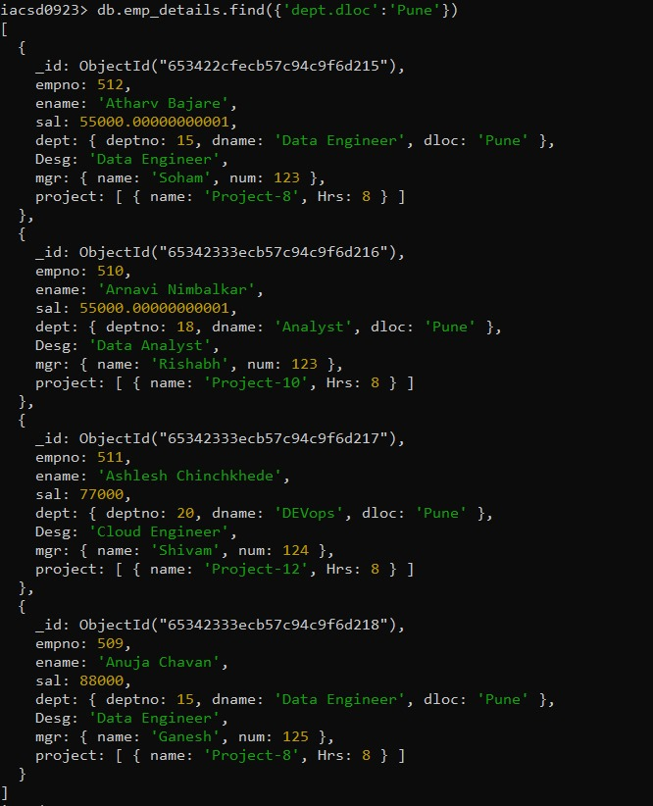
Update Operation
update_one(filter,update)
update_many(filter,update)

Slide 14
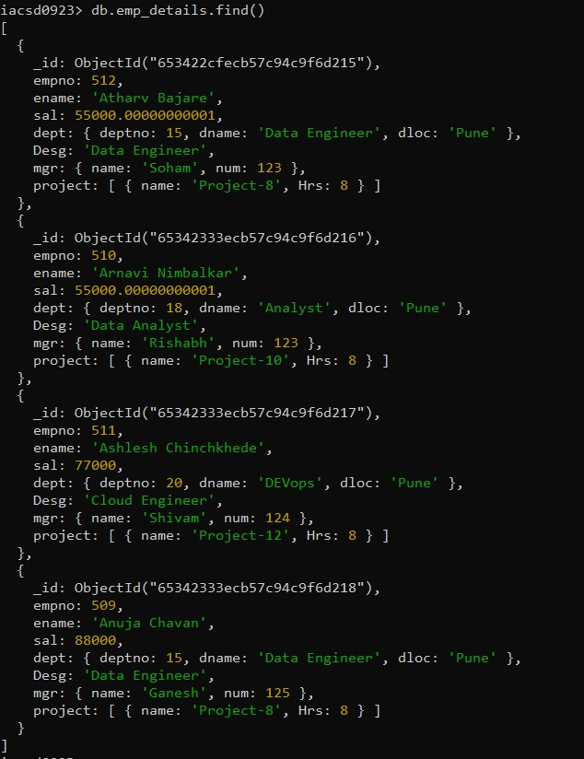
Deleting document

Slide 15
Pymongo Document
https://pymongo.readthedocs.io/

Slide 16
Thank You
Group ;- G3
Anuja Chavan 239509
Arnavi Nimbalkar 239510
Ashlesh Chinchkhede 239511
Atharv Bajare 239512

